Slide 1
BIRTH/DEATH REGISTRATION WITH SERVICES
PIP2001 Capstone Project
Review-0
Batch Number: PSCS201
Under the Supervision of,
Dr./Mr./Ms./Prof. Dr . Sukruth Gowda M A
Professor / Associate Professor / Assistant Professor
School of Computer Science and Engineering
Presidency University
Roll Number 20211CSE0541 20211CSE0536 20211CSE0433 | Student Name JOEL G DANIEL SAMIKSHA RAJAN SATHYA SREE E
Name of the Program: B.TECH
Name of the HoD: DR . AASIF MOHAMMED
Name of the Program Project Coordinator: Ms. HAJEERA NIKHAT KHANAM
Name of the School Project Coordinators: Dr. Sampath A K / Dr. Abdul Khadar A / Mr. Md Ziaur Rahman

Slide 2
Content
Problem Statement
Github Link
Analysis of Problem Statement
Timeline of the Project
References

Slide 3
Problem Statement Number:
Organization and Problem statement
Current systems for birth and death certification face issues like manual data entry errors, processing delays, and limited accessibility, especially in remote or underserved areas.
These challenges lead to time-consuming processes and errors, impacting healthcare planning and legal documentation.
AI technologies can be leveraged to create a more reliable, efficient, and user-friendly system for managing vital records.
This improved system would enhance public health management and social outcomes.

Slide 4
Problem Statement Number:
Category
- The birth/death certification project using AI falls under the software project category.
- It involves developing AI-based software applications to aid the certification process.
- The focus is on creating new methods for data processing, verification, and storage of digital records.
- The project aims to improve the management quality of vital statistics.
- While it may interact with hardware components like servers or data entry devices, the main focus is on software development, machine learning, artificial intelligence, and robotics.

Slide 5
Problem Statement Number:
Difficulty level
The birth/death certification project using AI is classified as moderate to high difficulty.
At the moderate level, it involves automating data entry, basic verification, and integration with current digital systems.
As the project scales, the complexity increases with building advanced AI models for data capture and verification across multiple geographies.
Privacy and security concerns, compliance with legal regulations, and handling messy or incomplete records add significant challenges.
While initially straightforward, the project's difficulty escalates based on implementation scope and goals.

Slide 6
Github Link
The Github link provided should have public access permission.
Github Link
https://github.com/joelgdaniel/Capstone-Project-birth-death-registration-with-services

Slide 7
Analysis of Problem Statement
Methodology
User/Admin login with authentication.
Dashboard navigation for managing registrations.
Selection of actions such as Register Birth, Register Death, View Records, or Update Applications.
Secure logout after completing all actions.
Algorithms
Step-by-Step Process
Login: Authenticate user/admin credentials.
Dashboard: Navigate to relevant functionalities.
Action Selection: Choose to register, view, update, or check status.
Submission: Save or finalize requests.
Logout: End session securely.
Technologies Used
Front-End: HTML, CSS, JavaScript
Back-End: PHP
Database: MySQL
Server Environment: XAMPP

Slide 8
Analysis of Problem Statement
Cloud Platforms:
Amazon Web Services (AWS): For scalable cloud computing, database management, and AI services like AWS Lambda, SageMaker, and RDS.
Frontend Development:
React.js / Angular / Vue.js: For building dynamic and user-friendly web interfaces for data entry and system access.
Bootstrap: A front-end framework for creating responsive web interfaces.
Figma / Adobe XD: For designing the UI/UX layout and prototypes before development.
Backend Development:
Node.js: For backend services that handle API requests and data management.
Django/Flask: For Python-based backend services, especially when working with machine learning models.
Spring Boot: For Java-based backend development.
Version Control and Collaboration:
GitHub/GitLab/Bitbucket: For hosting code repositories and team collaboration.

Slide 9
Analysis of Problem Statement (contd...)
Hardware Requirements:
Development Machines:
Processor: Intel Core i5 or AMD Ryzen 5
RAM: 8 GB
Storage: SSD with 256 GB

Slide 10
Analysis of Problem Statement (contd...)
Processor: Multi-core CPUs (Intel Xeon or AMD EPYC)
RAM: 16 GB or more
Storage: SSDs, capacity based on data volume
Network: High-speed internet for cloud and remote access
This setup will ensure you have the right tools and resources to build and manage your AI-driven certification system effectively

Slide 11
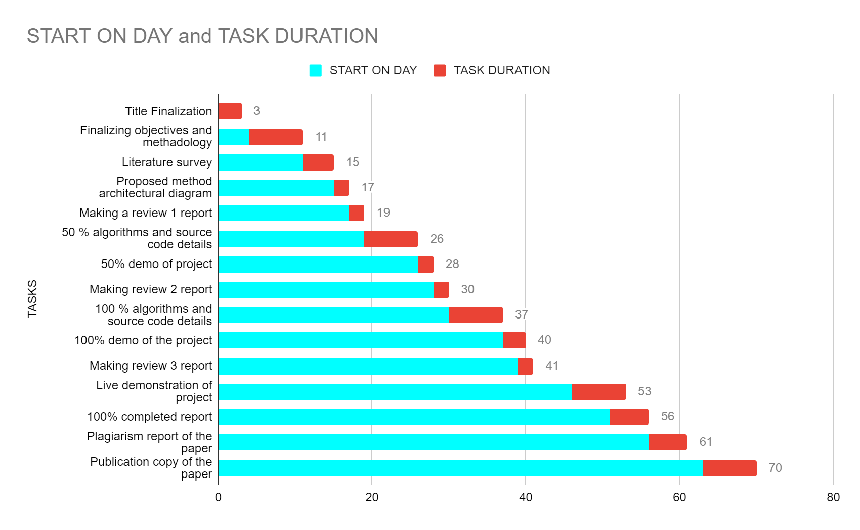
Timeline of the Project (Gantt Chart)

Slide 12
References (IEEE Paper format)
https://www.nielit.gov.in/chandigarh/content/digitization-death-birth-records
https://unstats.un.org/unsd/demographic-social/crvs/documents/IIVRS_papers/IIVRS_paper26.pdf

Slide 13


